Slide 1

The Role of AI/ML in Cybersecurity
Dr. Bhale Pradeepkumar, Assistant Professor Department of Computer Science & Engineering, IIITDM Kancheepuram pradeepkumar@iiitdm.ac.in

Slide 2
Outline
Cyber security Research & Core Capability @IIT Guwahati
Statistics, Machine Learning & AI
Defining the concepts
Third Wave of AI
Need for Explainable AI
Motivation
Research Methodology
Use Cases
IoT security system
Cyber Security Application

Slide 3
ML and AI – What Is It?
Machine Learning – Algorithmic ways to “describe” data
Supervised - learning from training data
Unsupervised - optimization problem to solve (clustering, dim reduction)
Deep Learning – a ‘newer’ machine learning algorithm
Eliminates the feature engineering step
Verifiability / explainability issues
Data Mining – Methods to explore data – automatically and interactively
Artificial Intelligence – “Just calling something AI doesn’t make it AI.”
“A program that doesn't simply classify or compute model parameters, but comes up with novel knowledge that a security analyst finds insightful.”
We don’t have artificial intelligence (yet)

Slide 4
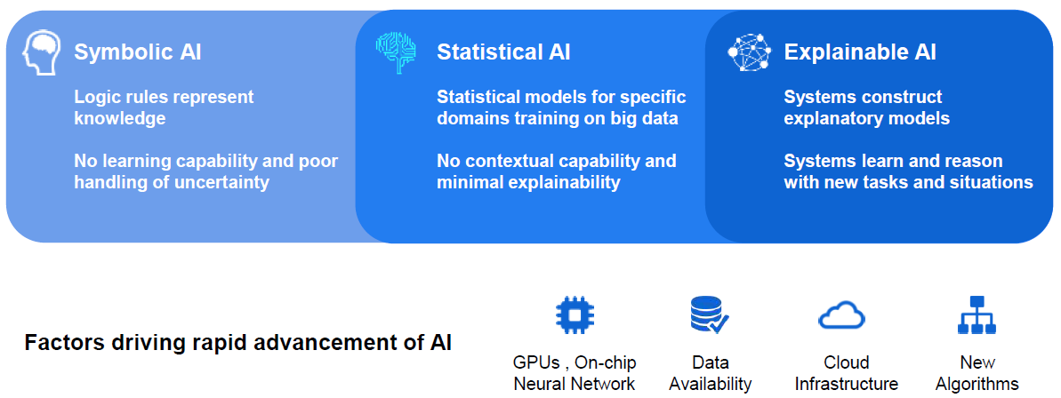
Third Wave of AI

Slide 5
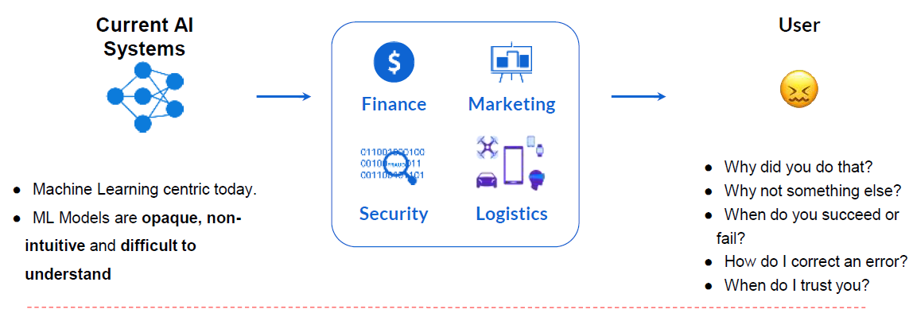
Need for Explainable AI
Explainable AI and ML is essential for future customers to understand, trust, and effectively manage the emerging generation of AI applications

Slide 6
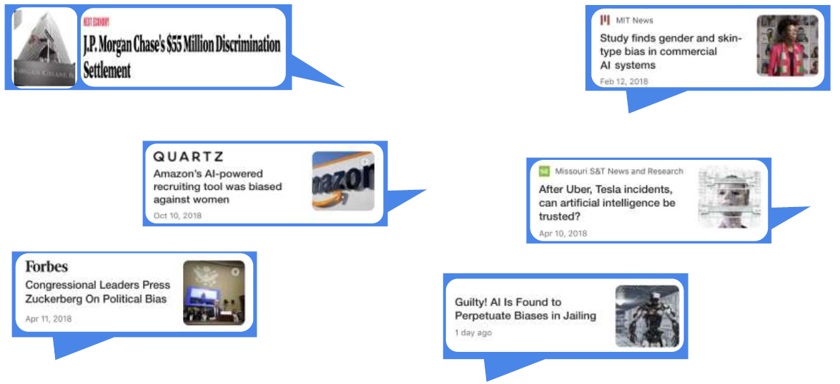
Black-box AI creates business risk for Industry

Slide 7
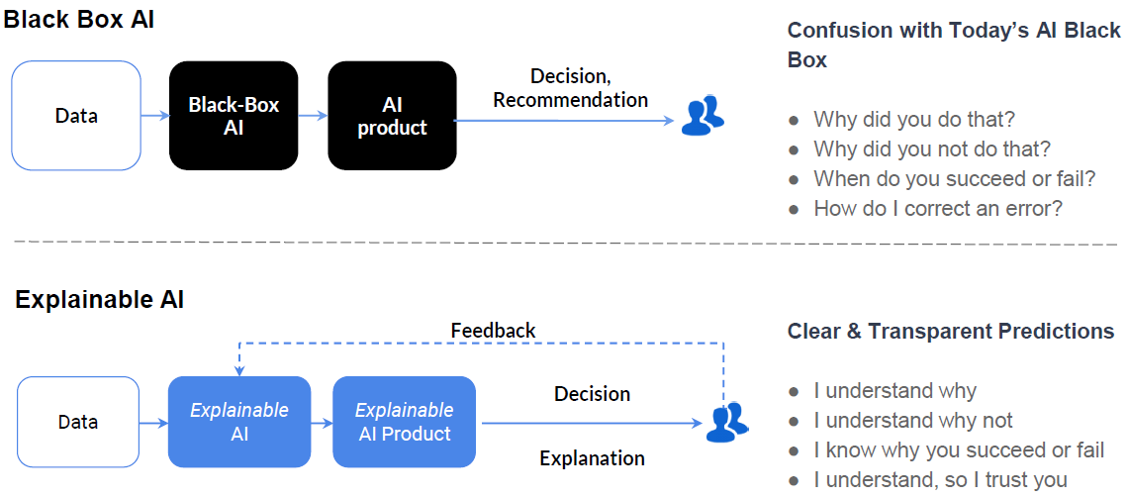
What is Explainable AI?

Slide 8
Why Explainability: Verify the ML Model / System

Slide 9
Why Explainability: Improve ML Model

Slide 10


Motivation
Two Mega Trends Impacting Cyber Security
Growth of Malware
With over 12 million new malicious threats created every month by hackers around the globe, we have exceeded the capacity of the threat research community to identify, research and write signatures for each threat
Growth of Devices
With 50B devices being connected to public and private networks by 2020, the attack surface has increase exponentially

Slide 11
Three Cyber Security Problems Ripe for Artificial Intelligence
Malware Detection
Leveraging the power of machine learning to detect and prevent zero-day and polymorphic malware across multiple threat vectors and platforms
Stream Analysis
Leveraging the power of machine learning to identify anomalous activity in system logs and network activity
Threat Intelligence
Leveraging the power of machine learning and Natural Language Processing (NLP) to prioritize alerts and provide automated threat research

Slide 12
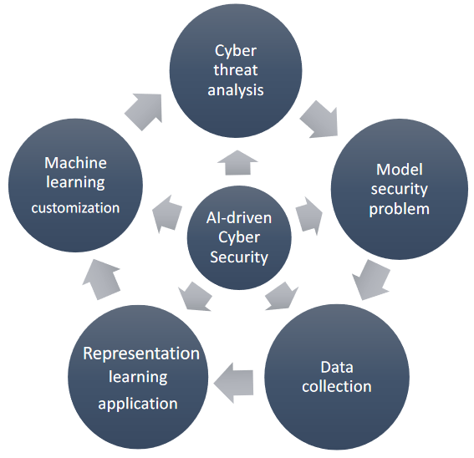
Research Methodology

Slide 13
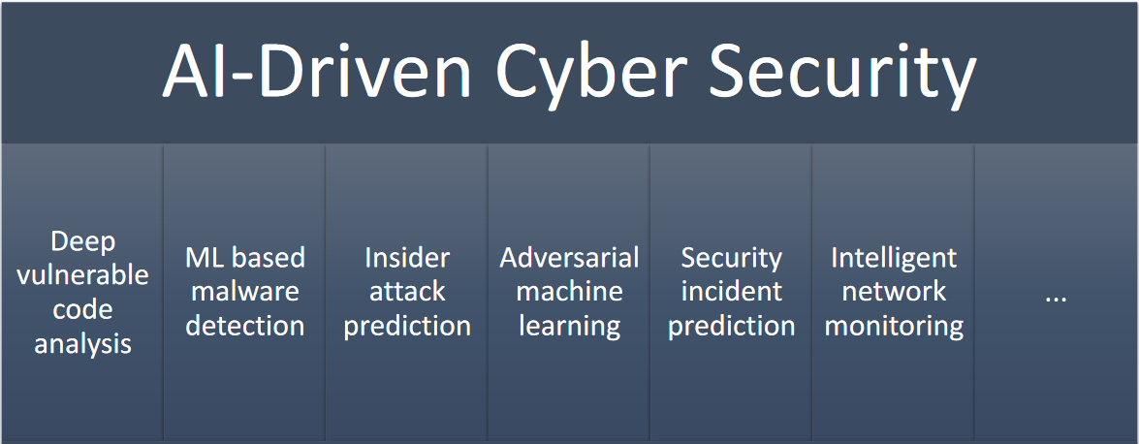
Use Cases

Slide 14
Cyber security: Use case IoT Ecosystem

Slide 15
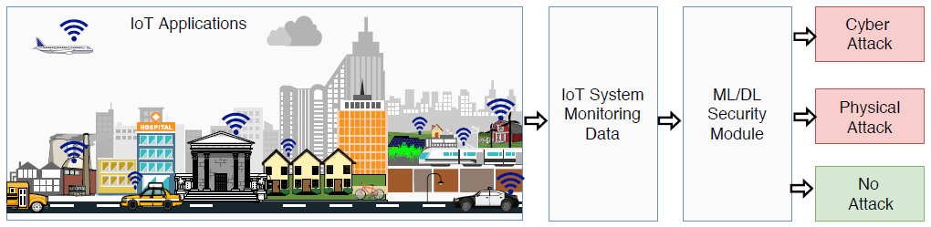
IoT security system
Fig : A big picture of the general learning based IoT security system.

Slide 16
The threat model in Internet of Things.

Slide 17
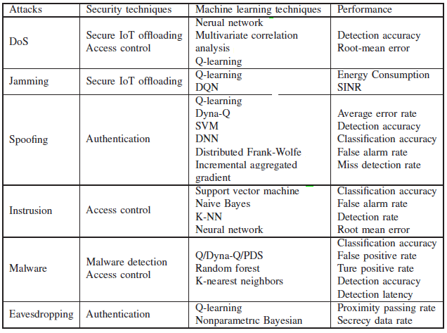
ML-based IoT security methods

Slide 18
ML-based authentication in IoT systems.
Traditional authentication schemes are not always applicable to IoT devices
Limited computation,
battery and
memory
Deep learning techniques such as DNN can be applied for IoT devices with sufficient computation and memory resources to further improve the authentication accuracy.

Slide 19
ML-based offloading
IoT offloading has to address the attacks launched from the PHY- or MAC- layer attacks.
jamming,
rogue edge devices,
rogue IoT devices,
eavesdropping,
man-in-the-middle attacks, and smart attacks .

Slide 20
ML-based offloading
The Deep Q-network (DQN)-based anti jamming transmission accelerates the learning speed for IoT devices
convolutional NN (CNN) to compress the state space for large-scale networks with a large number of IoT devices and jamming policies in a dynamic IoT system and thus increase the SINR of the received signals.
The output of the CNN is used for estimating the values of the Q-function for each anti jamming transmission policy.
This scheme increases the SINR of the received signals by 8.3% and saves 66.7% of the learning time compared with the Q-learning scheme in the offloading against jamming attacks.

Slide 21
ML-based malware detection

Slide 22
ML-based malware detection
IoT devices can apply supervised learning techniques to evaluate the runtime behaviors of the apps in malware detection.
IoT device uses K-NNs and random forest classifiers to build the malware-detection model.
IoT device filters the TCP packets and selects the features among various network features including the frame number and length, labels them, and stores these features in the database.
True positive rates of the K-NN-based malware detection and random forest-based scheme with the MalGenome data set are 99.7% and 9 9.9%, respectively

Slide 23
Cyber Security Application

Slide 24

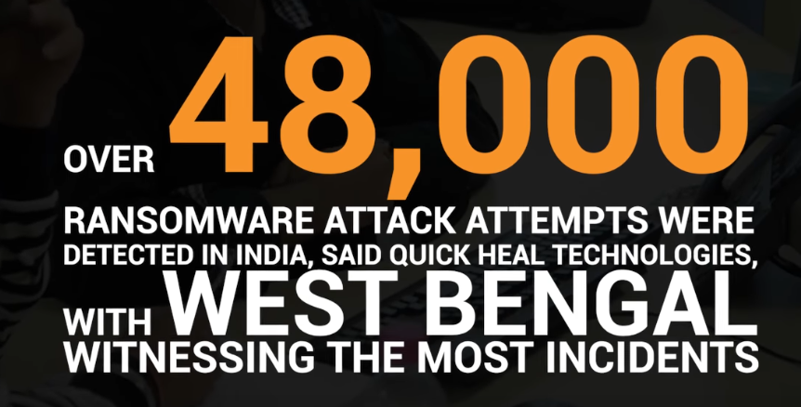
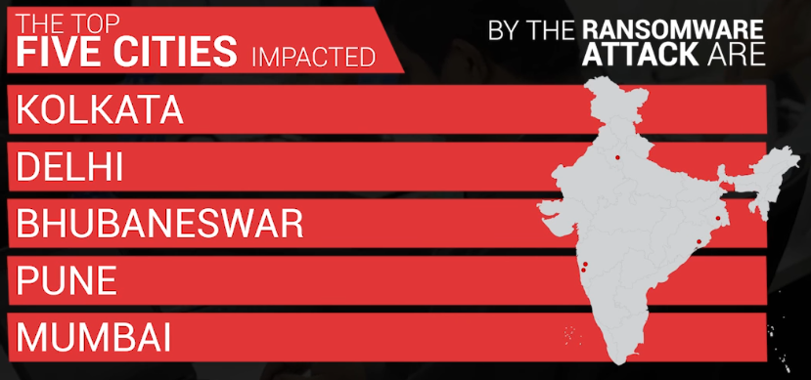
Ransomware Detection
A ransomware attack can encrypt critical data, causing huge damages
Research Objective:
Ransomware life cycle
Software similarity and classification
Propagation modelling
Intelligent detection

Slide 25
Insider Attack Detection
Insider attacks are highlighted as “the most damaging risk”
We design a novel fine-grained anomaly behaviour identification system to predict cyber insider attacks
It can analyse big behaviour data, making real-time decision, and learning varying behaviour features,
It can provide maximised protection to large-scale private networks

Slide 26
Classifying Internet Traffic for Security Applications
Develop a set of novel techniques for Internet traffic classification, which is important to defend against the serious cyber-attacks and effectively minimize the damage
Real-time
Scalable
Robust
Private

Slide 27
References
Xiao, L., Wan, X., Lu, X., Zhang, Y., & Wu, D. (2018). IoT security techniques based on machine learning: How do IoT devices use AI to enhance security?. IEEE Signal Processing Magazine, 35(5), 41-49.
Tang, Jie, Dawei Sun, Shaoshan Liu, and Jean-Luc Gaudiot. "Enabling deep learning on IoT devices." Computer 50, no. 10 (2017): 92-96.
Cp, P., Narayanan, S., Kommuri, V. S., Subramanian, S., Bijlani, K., Nagendra, S., & Podila, N. ICACCI-02 (A): Artificial Intelligence and Machine Learning/Data Engineering/Biocomputing (Regular Papers).
Vermesan, Ovidiu, Arne Bröring, Elias Tragos, Martin Serrano, Davide Bacciu, Stefano Chessa, Claudio Gallicchio et al. "Internet of robotic things: converging sensing/actuating, hypoconnectivity, artificial intelligence and IoT Platforms." (2017): 97-155.
Diro, Abebe Abeshu, and Naveen Chilamkurti. "Distributed attack detection scheme using deep learning approach for Internet of Things." Future Generation Computer Systems 82 (2018): 761-768.

Slide 28
References
Kumar, P.M., Gandhi, U., Varatharajan, R., Manogaran, G., Jidhesh, R. and Vadivel, T., 2017. Intelligent face recognition and navigation system using neural learning for smart security in Internet of Things. Cluster Computing, pp.1-12.
Lee, Jong-Hyouk, and Hyoungshick Kim. "Security and privacy challenges in the internet of things [security and privacy matters]." IEEE Consumer Electronics Magazine 6, no. 3 (2017): 134-136.
Al-Turjman, Fadi, ed. Artificial Intelligence in IoT. Springer, 2019.
Chen, Yan-Ju, Wen-Han Kuo, Sung-Yun Tsai, Jiann-Liang Chen, Yu-Hung Chen, and Wei-Zhao Xu. "Artificial Intelligence Hybrid Learning Architecture for Malware Families Classification." In 2019 21st International Conference on Advanced Communication Technology (ICACT), pp. 503-510. IEEE, 201

Slide 29
Thank You

Slide 30


